Slide 1
Business Process Lifecycle
Design and Analysis
Configuration
Enactment
Evaluation
Administration and Stakeholders

Slide 2
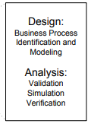
Design and Analysis
The business process lifecycle is entered in the Design and Analysis phase, in which surveys on the business processes and their organizational and technical environment are conducted.
Based on these surveys, business processes are identified, reviewed, validated, and represented by business process models.
Once an initial design of a (BP) is developed,
it needs to be validated.

Slide 3
Instrument to validate
A useful instrument to validate a business process is a workshop, during which the persons involved discuss the process.
The participants of the workshop will check whether all valid business process instances are reflected by the business process model.

Slide 4
Simulation
Simulation techniques can be used to support validation, because certain undesired execution sequences might be simulated that show deficits in the process model.
Simulation of business processes also allows stakeholders to walk through the process in a step-by-step manner and to check whether the process actually exposes the desired behavior.
Most business process management systems provide a simulation environment that can be used in this phase.

Slide 5
Final Outcome
Business process modelling has an evolutionary character in the sense that the process model is analyzed and improved so that it actually represents the desired business process and that it does not contain any undesired properties.

Slide 6

Configuration
Once the business process model is designed and verified, the business process needs to be implemented.
There are different ways to do so.
It can be implemented by a set of policies and procedures that the employees of the enterprise need to comply with.

Slide 7
Configuration
Configuration includes the interactions of the employees with the system as well as the integration of the existing software systems with the business process management system.
In today’s business organizations, most business processes are supported by existing software systems. Depending on the information technology infrastructure, the process configuration phase might also include implementation work.

Slide 8
ACID principle
Transactions are a well-known concept from database technology, where a transaction manager guarantees that application programs run as transactions and obey the ACID principle
A: Atomicity (All or None)
C: Consistency (Measure of correctness)
I: Isolation (No one around you)
D: Durability
These are the four properties of transaction database

Slide 9
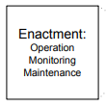
Enactment
The process enactment phase encompasses the actual run time of the business process. E.g., m/c time
Business process instances are initiated to fulfil the business goals of a company. E.g., Actual production
A monitoring component of a business process management system visualizes the status of business process. E. g., ticket counter

Slide 10
Enactment
Process monitoring is an important mechanism for providing accurate information on the status of business process instances.
This information is valuable, for instance, to respond to a customer request that inquires about the current status of his case.
During business process enactment, valuable execution data is gathered, typically in some form of log file. These log files consist of ordered sets of log entries, indicating events that have occurred during business processes.
Start of activity and end of activity is typical information stored in execution logs.

Slide 11
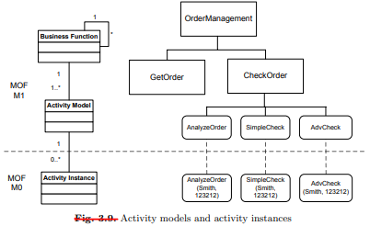
Log File
This section investigates how activities can be described

Slide 12
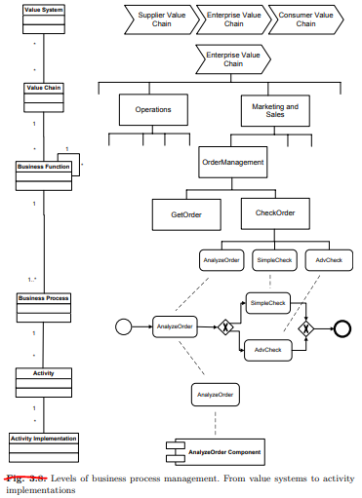

Slide 13

Evaluation
The evaluation phase uses information available to evaluate and improve business process models and their implementations.
Execution logs are evaluated using business activity monitoring and process mining techniques.
These techniques aim at identifying the quality of business process models and the adequacy of the execution environment.

Slide 14
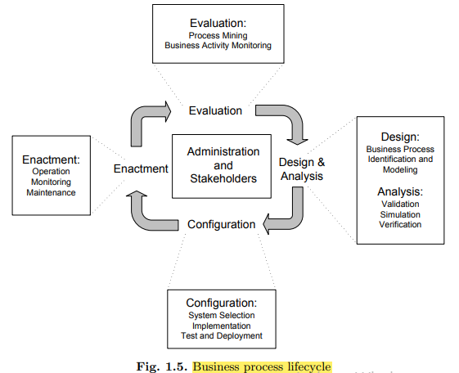

Slide 15
Administration and Stakeholders
The business process domain is characterized by several types of stakeholders with different knowledge, expertise, and experience; these are classified into the following roles:
Chief Process Officer: The chief process officer is responsible for standardizing and harmonizing business processes in the enterprise.
He/she is responsible for the evolution of business processes in the presence of changing market requirements.
Business Engineer: Business engineers are business domain experts responsible for defining strategic goals of the company and organizational business processes.

Slide 16
Administration and Stakeholders
Process Designer : Process designers are responsible for modelling business processes by communicating with business domain experts and other stakeholders. Very good analytical capabilities and excellent communication skills are important for a process designer.
Process Participant: Process participants conduct the actual operational work during the enactment of business process instances
Knowledge Worker :Knowledge workers are process participants who use software systems to perform activities in a business process.

Slide 17
Administration and Stakeholders
Process Responsible: Each business process model is assigned an individual who is responsible for the correct and efficient execution of all business processes using this model.
System Architect: System architects are responsible for developing and configuring business process management systems so that the configured business process management system enacts the business processes in the context of the information systems infrastructure at hand.

Slide 18
Administration and Stakeholders
Developers: Developers are information technology professionals who create software artefacts required to implement business processes. The implementation of interfaces to existing software systems is an important area of work for developers.

Slide 19
References
Please read article 1.2 from book
For more information read article 3.4,3.5
Business Process Management by Mathias weske

